Slide 1


El Segundo Aquatic Rental Group Evaluation
2023

Slide 2
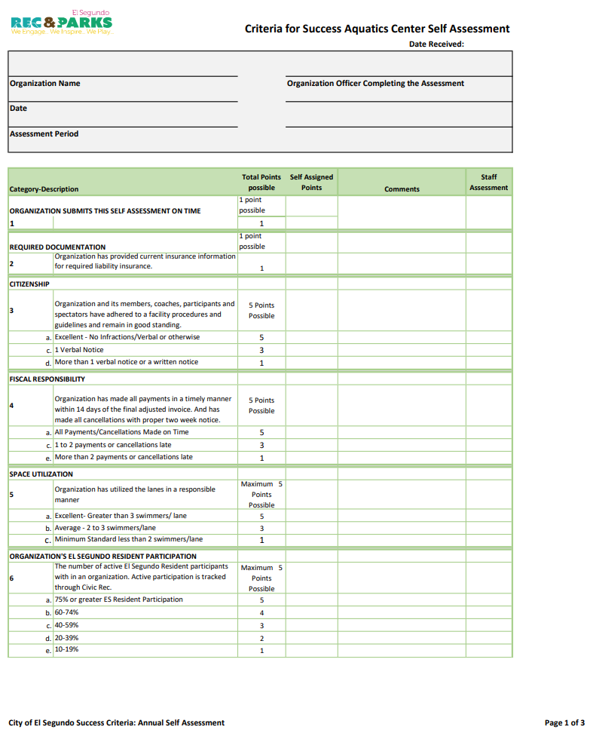
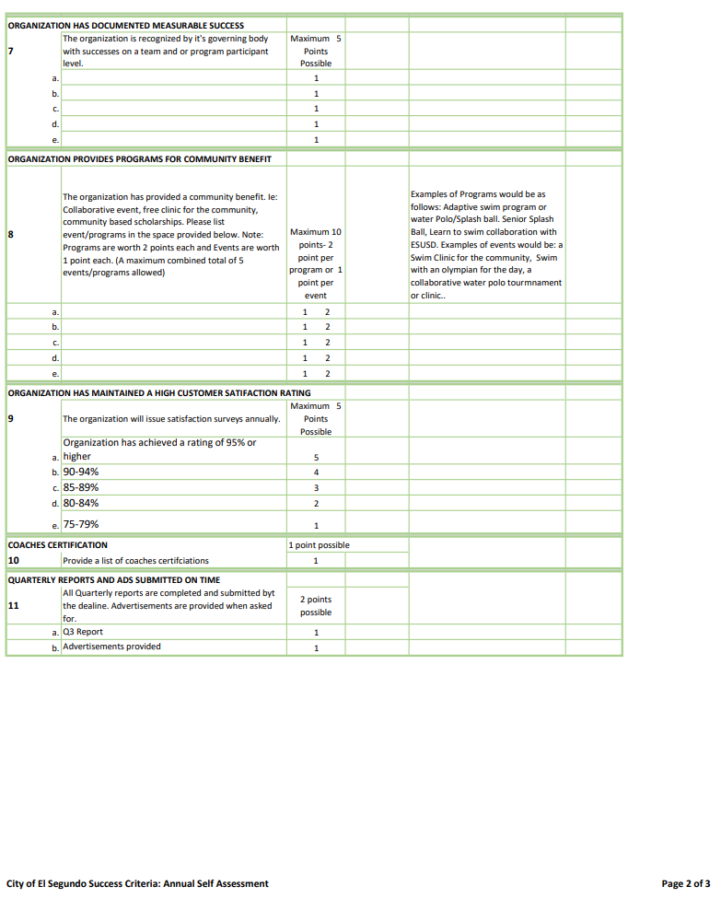
Sample Document

Slide 3
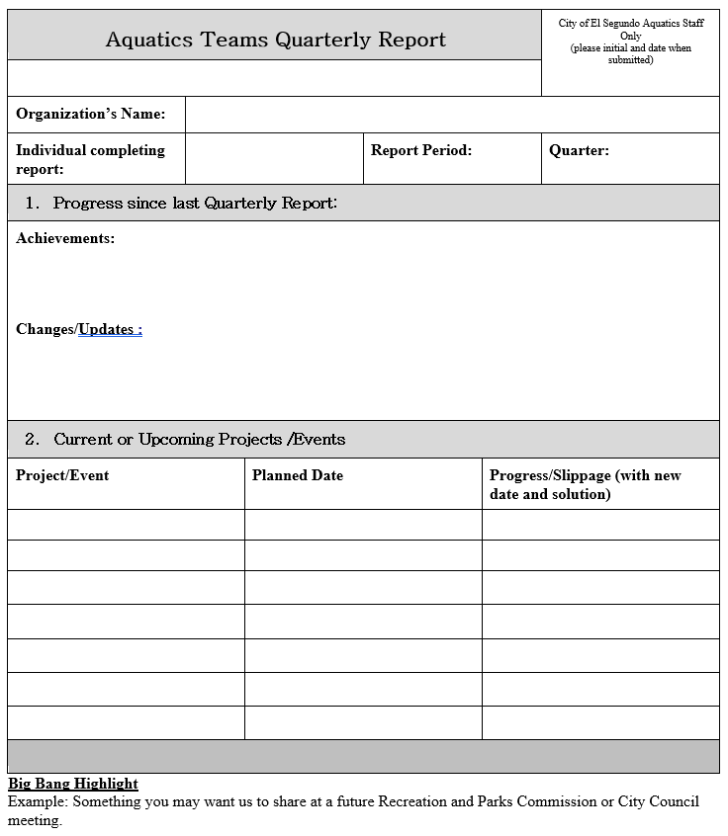

Slide 4
Alpha Aquatics
Youth Swim Club
107 new team records in 2023
3rd overall and 1st in men's medium team division at Winter Sectionals
2nd at summer age group champs Notably Anthony Gullickson who won all 6 of his individual events
Qualified 5 swimmers in summer Jr nationals

Slide 5

Alpha Aquatics
Group Score
Coaching staff certifications provided?
Rosters provided?
Quarterly reports turned in?
Self assessed score: 36
Staff assessed score: 36
Limiting Factors: Self scored 2/5 points in El Segundo resident participation(20%-39%) and 4/10 points in community benefit programs.

Slide 6
South Bay United
Youth Water Polo Club
Competed in Junior Olympics for all teams
First time having a 12U girls team compete in junior Olympics

Slide 7

South Bay United
Group Score
Coaching staff certifications provided?
Quarterly reports turned in?
Rosters provided?
Self assessed score: 45
Staff assessed score: 25
Limiting Factors: Did not provide rosters, insurance, or coaching staff certifications. Also lost points for documented measurable success and programs for community benefit

Slide 8
Coastal Masters
Adult Water Polo Club
138 members making it one of the largest active masters water polo clubs in the country
Over summer, ran a weekly women's game – Only open/drop in women's game in the area

Slide 9
Coastal Masters
Group Score
Coaching staff certifications provided?
Quarterly reports turned in?
Rosters provided?
Self assessed score: 32
Staff assessed score: 32
Limiting Factors: Lost points for no additional programs for community benefit and self scored low on El Segundo resident participation

Slide 10
Tower 26
Adult Triathlon Training Club
20 athletes qualified for triathlon world championship
Waikiki Rough water overall women's winner
Professional triathlete Lionel Sanders joins tower 26
Podcast downloads exceed 2 million
USA swimming 8-time national open water coach joins Tower 26 staff

Slide 11
Tower 26
Group Score
Quarterly reports turned in?
Coaching staff certifications provided?
Rosters provided?
Self assessed score: 34
Staff assessed score: 32
Limiting Factors: Did not submit rosters. Self scored 3/5 points on customer satisfaction ratings

Slide 12
SCAQ
Adult Masters Team
35 in Natchaps 101 pier to pier
400 individuals in ocean clinics
400 individuals in pool clinics over summer
200 new swimmer intros

Slide 13
SCAQ
Group Score
Coaching staff certifications provided?
Rosters provided?
Quarterly reports turned in?
Self assessed score: 42
Staff assessed score: 21
Limiting Factors: Did not submit rosters or coaching certifications. Did not submit quarterly report and did not provide backup for documented measurable success

Slide 14
Beach Cities Swimming
Youth Swim Club
1st place over at 2023 SCS (Summer Junior Olympics)
Ranked 104th nationally in USA swimming’s virtual club championships - # 7 in So Cal Swimming
24th place at USA swimming futures championships
Bella Brito #14 college recruit in entire country
Coach Tim Murphy was named as 2023 national top 50 age group coaches by American Swimming Coaches Association
Grown team by 82 athletes from 319 to 401
NEW Intro to Pre-Comp program

Slide 15
Beach Cities Swimming
Group Score
Quarterly reports turned in?
Coaching staff certifications provided?
Rosters provided?
Self assessed score: 35
Staff assessed score: 35
Limiting Factors: Scored 1/5 points for ES residency (10-19%). 4/10 points for community benefit

Slide 16
Trojan Water Polo
Youth Water Polo Club
50% off dues to all El Segundo/Da Vinci residents
10 teams compete in Junior Olympics
Hired Former LMU asst. Coach Kyle Nadel as Age Group Coordinator

Slide 17
Trojan Water Polo
Group Score
Rosters provided?
Quarterly reports turned in?
Coaching staff certifications provided?
Self assessed score: 41
Staff assessed score: 41
Limiting Factors: Didn’t score full points on El Segundo Resident participation and providing events for community benefit

Slide 18
Aquatic Rental Scores

